Slide 1











As-Is Situation (Manual Effort | Lack Of Visibility)
Spreadsheet/ MatchForce Update
Match Coordinator
Time Consuming
Each MEC may coordinate up to 60 Volunteers / Matches

Slide 2

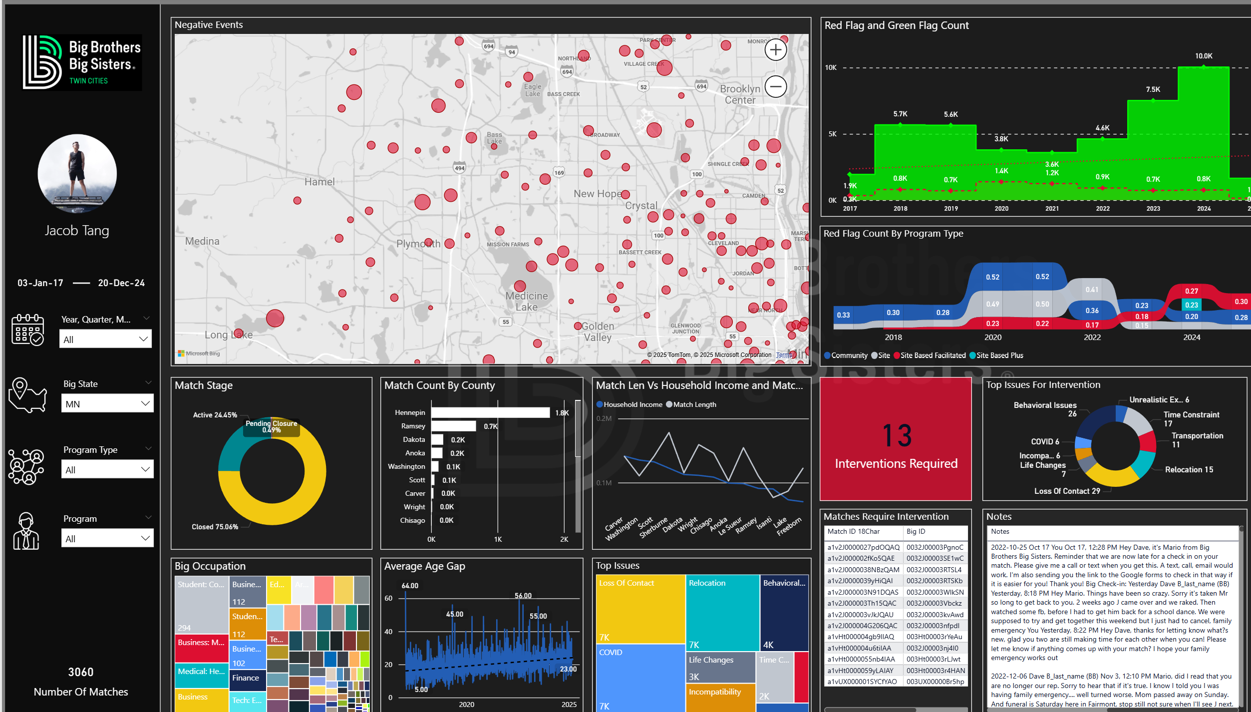



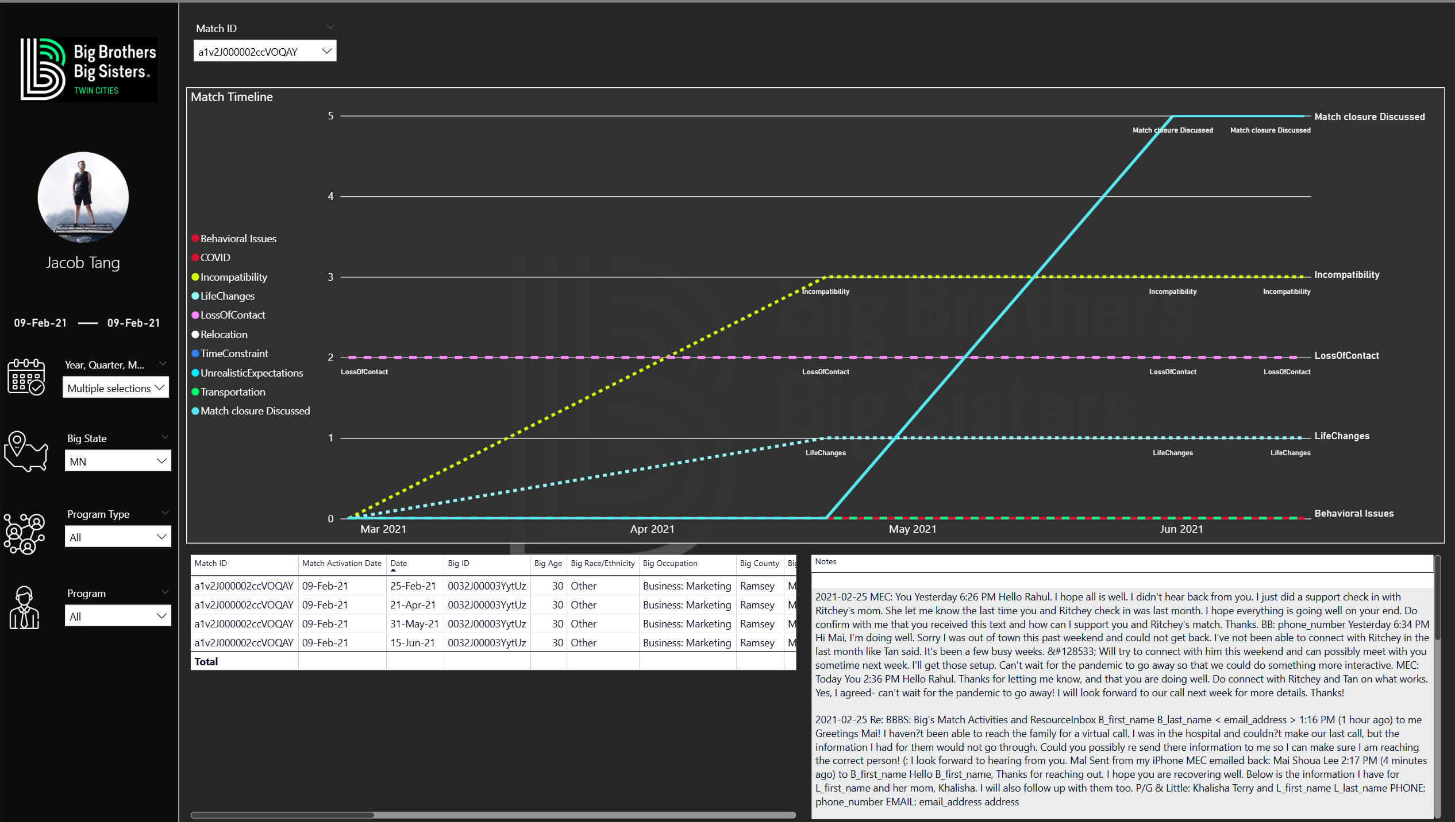
Our Solution (Automation | Visibility | Alerts)
Dashboard
Match Coordinator
LLM Call Bot
Speech Recognition / MatchForce API
Match Event View
LLM
(Event Detection)
Match View
60 Volunteers / Matches

Slide 3

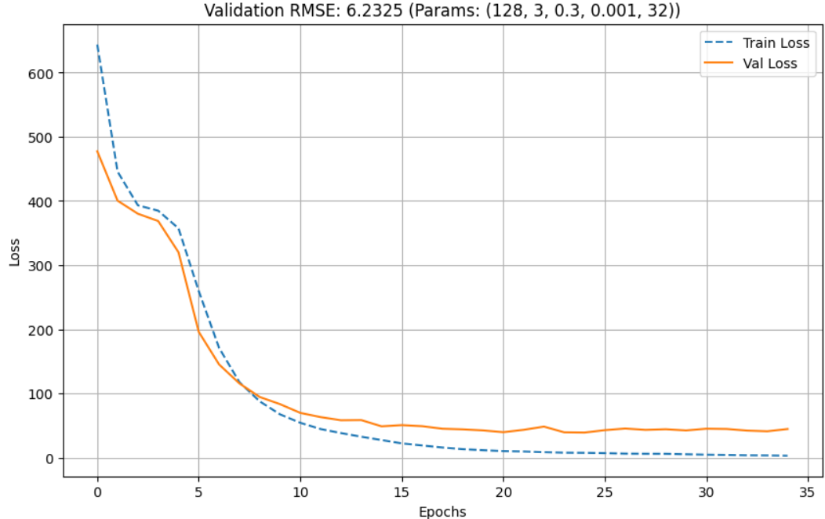
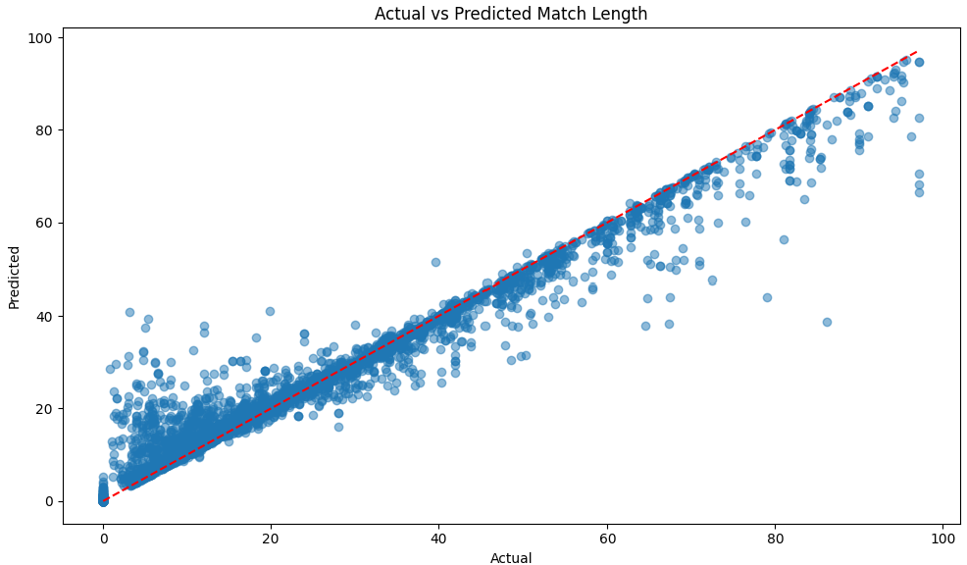







Pipeline Overview
Model Prediction
LSTM (Deep Learning)
Train Dataset
Data & Alert Driven Decision
Test Dataset
Manual Data Cleaning
Power Bi
XAI GROK
(Event Detection)
External Data
Research Papers
GeoPandas
USA Census
BBB
Google Scholar
Data Producers
Data Processing Pipeline
Data Consumers

Slide 4
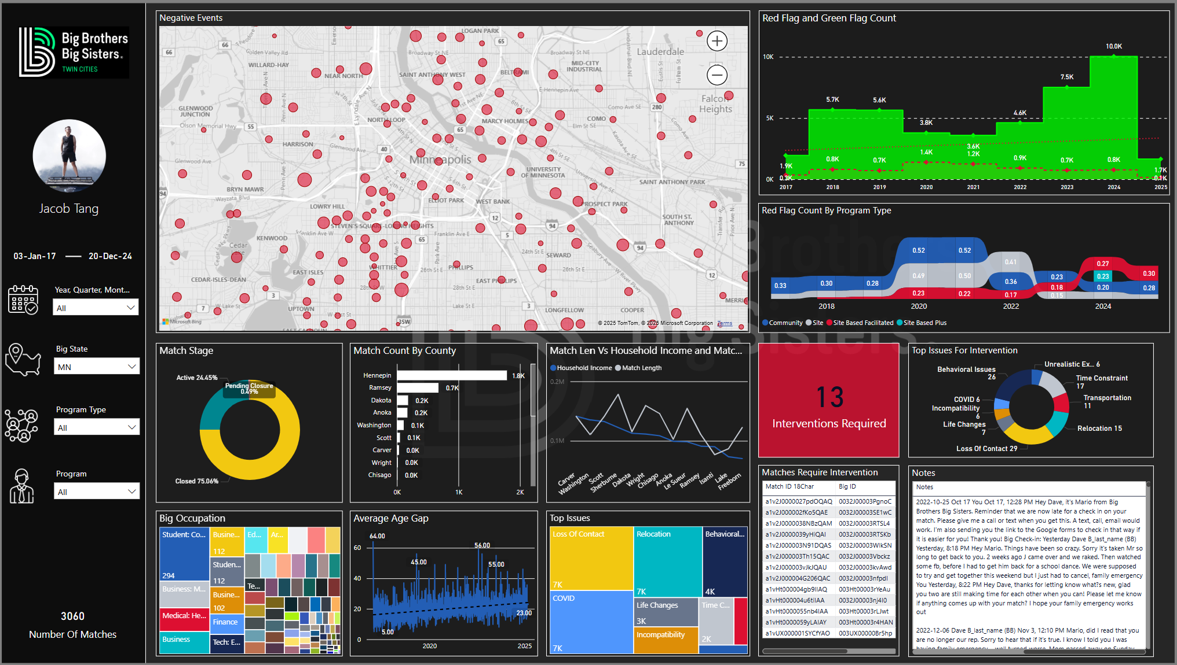

Slide 5
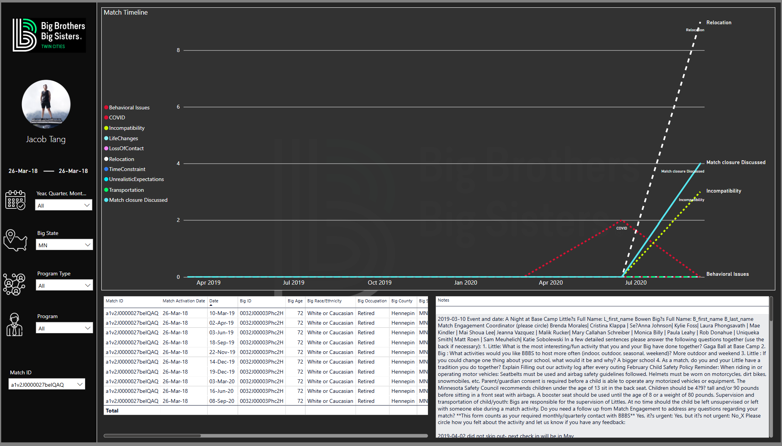

Slide 6
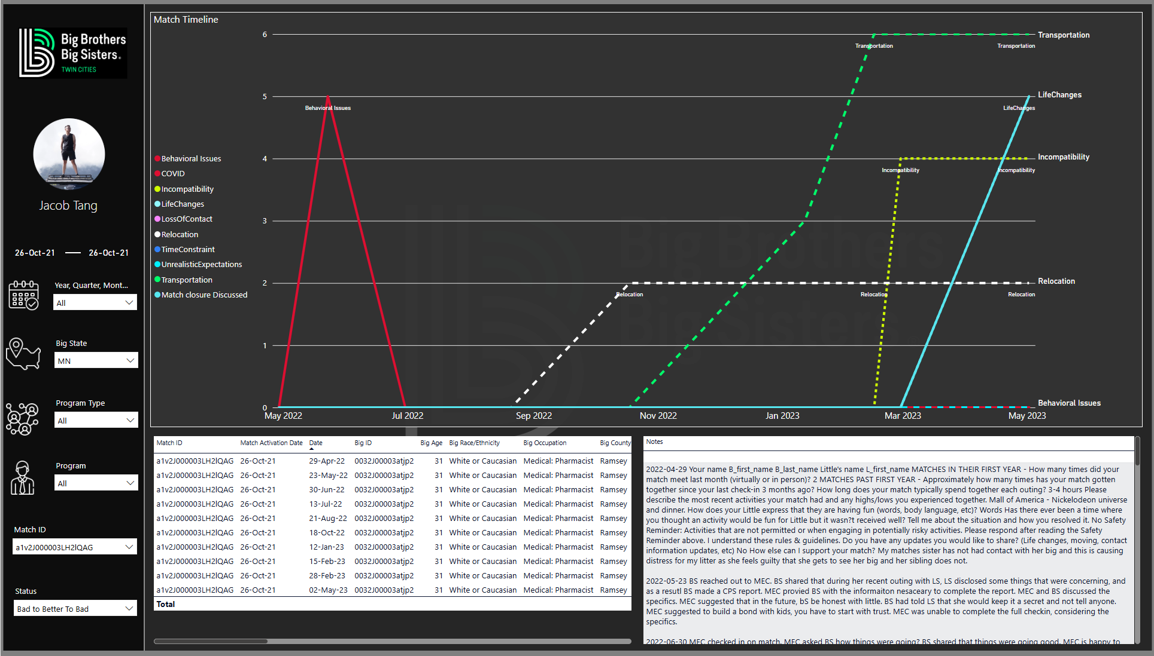

Slide 7
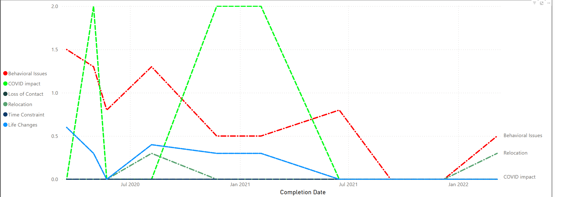
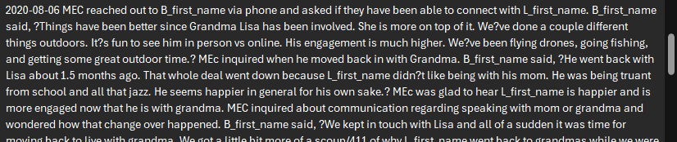
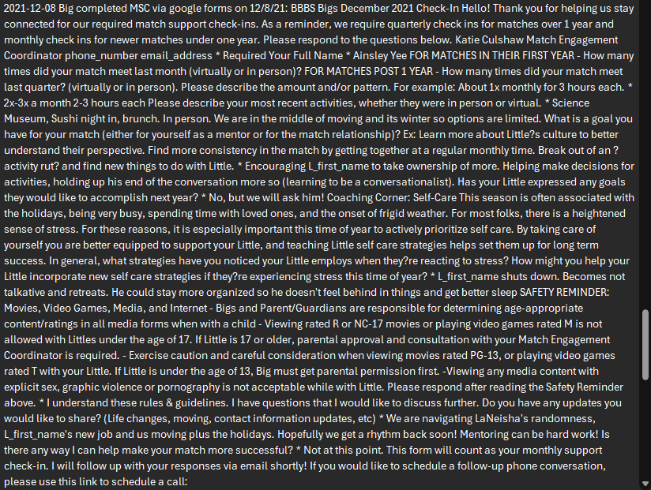
a1v2J000002ug91QAA

Slide 8
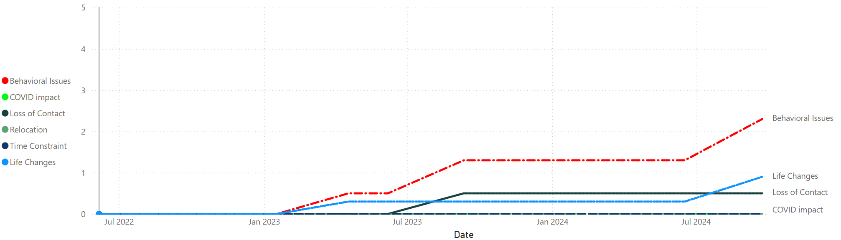
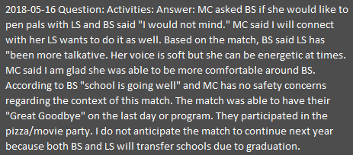

Slide 9
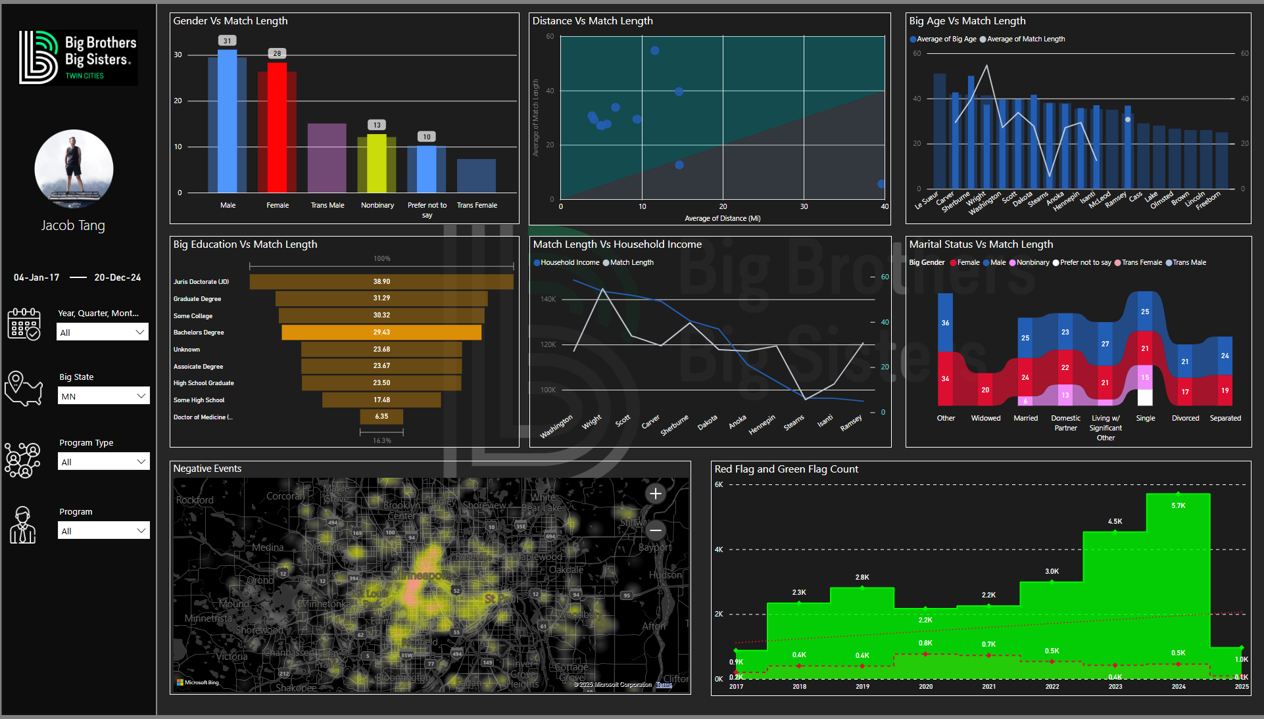

Slide 10
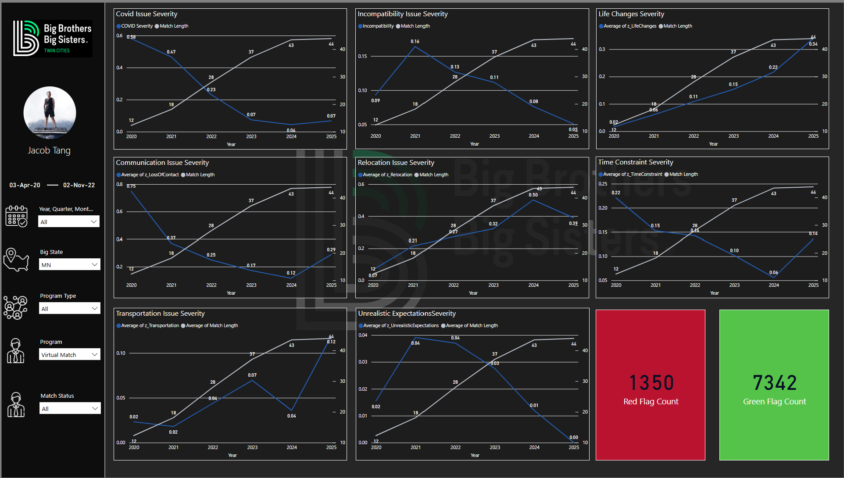

Slide 11



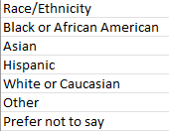
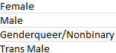
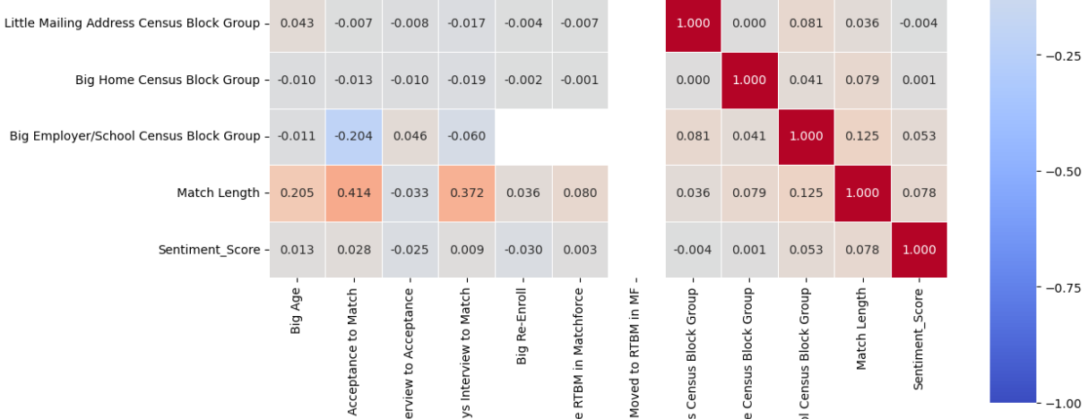
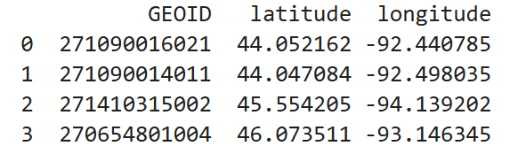
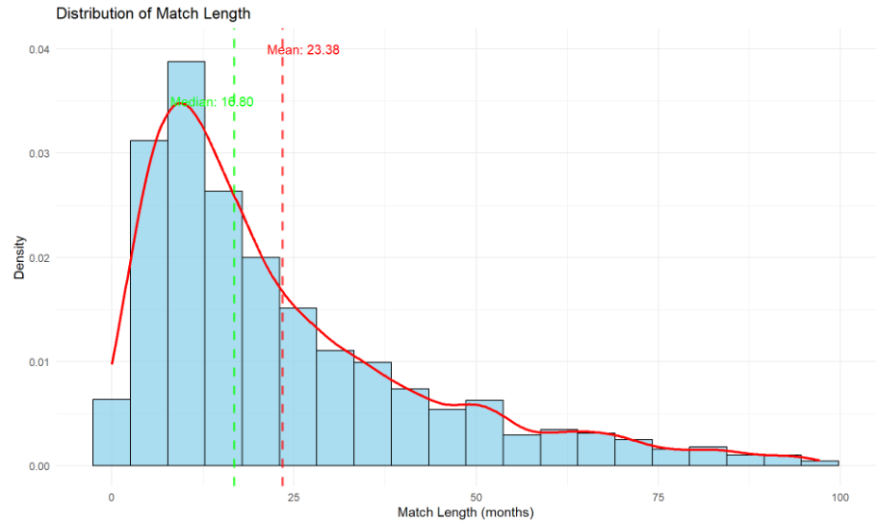
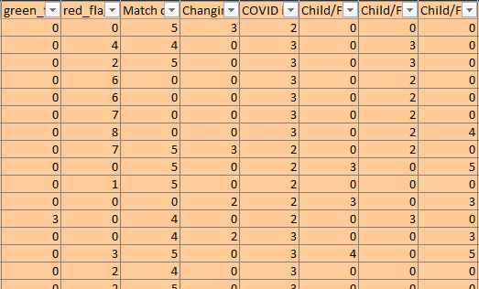
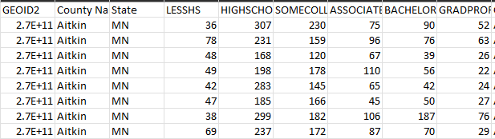
Manual Processing
Match Length Stats Analysis with Pandas:
Correlation
Standard Deviation
Outliers
Closure Seasons
Recategorization of categories to reduce category Count:
Gender
Race
Education Level
Occupation
Extract centroid (Latitude, Longitude) From .shp files for each census block.
- Adds Distance Value between Big and Small
GeoPandas
GeoPandas
Transformation of nested Temporal Features into column Features for LSTM Training.
Impute/Add missing Columns:
Education
Mean / Median Income
Race
USA Census

Slide 12


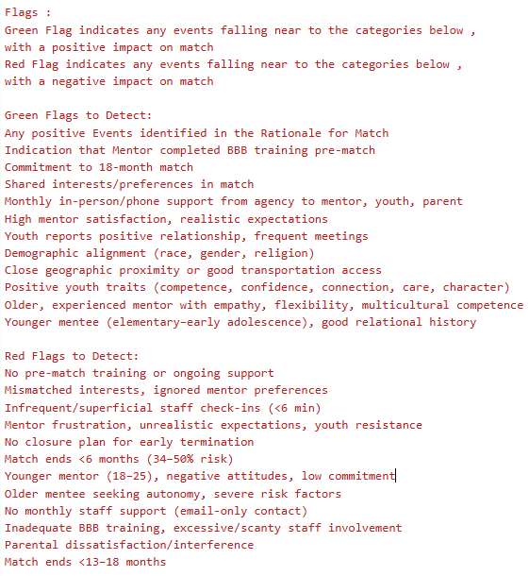
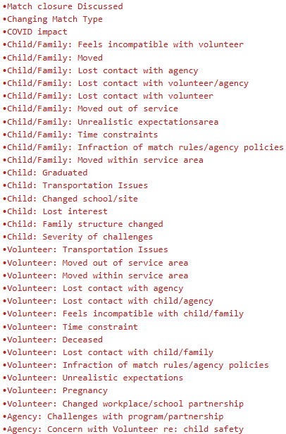
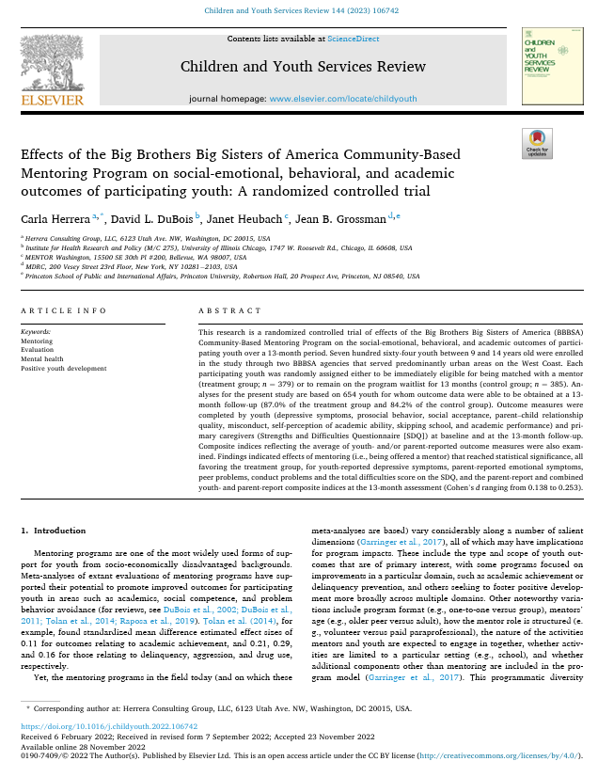

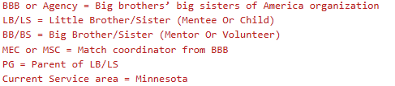
Prompt Context
Research Papers
Context Prompt Green / Red Flags (Cached Context)
Context Prompt Negative Events
(Cached Context)
BBB
Google Scholar

Slide 13

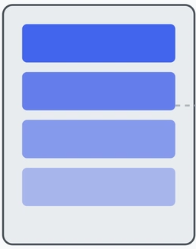
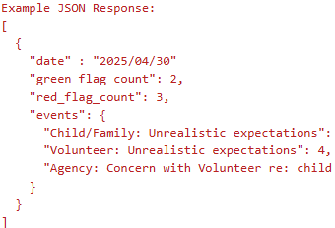

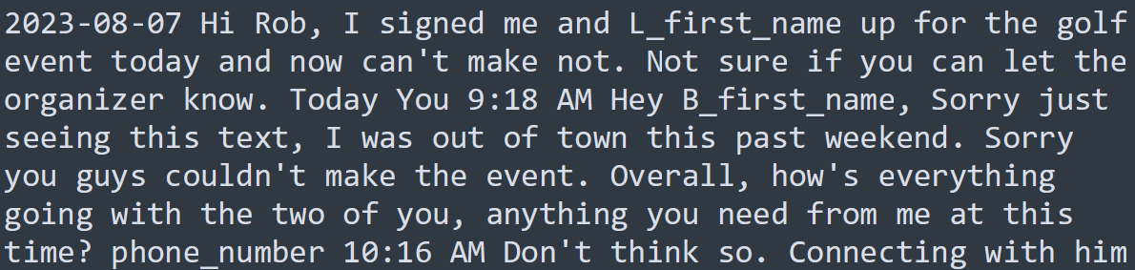
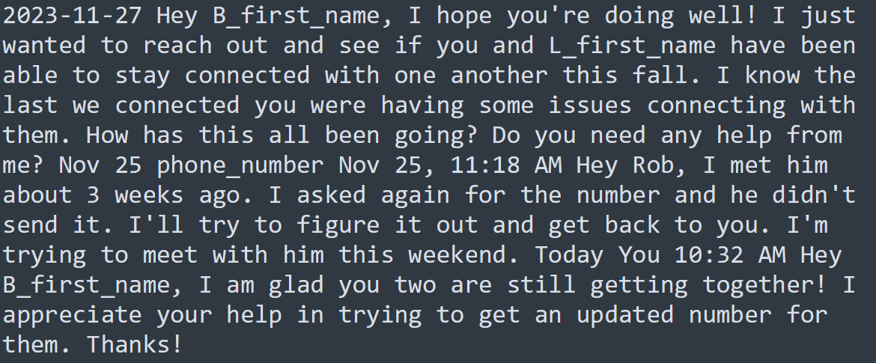
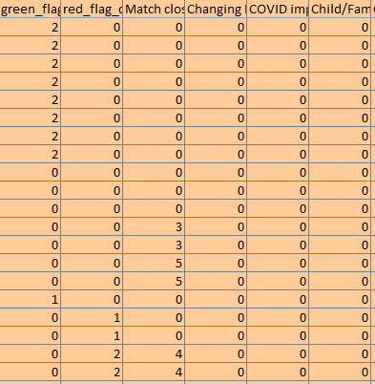
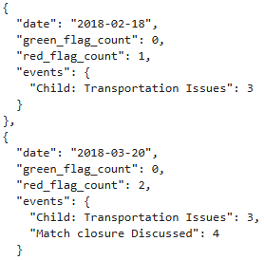
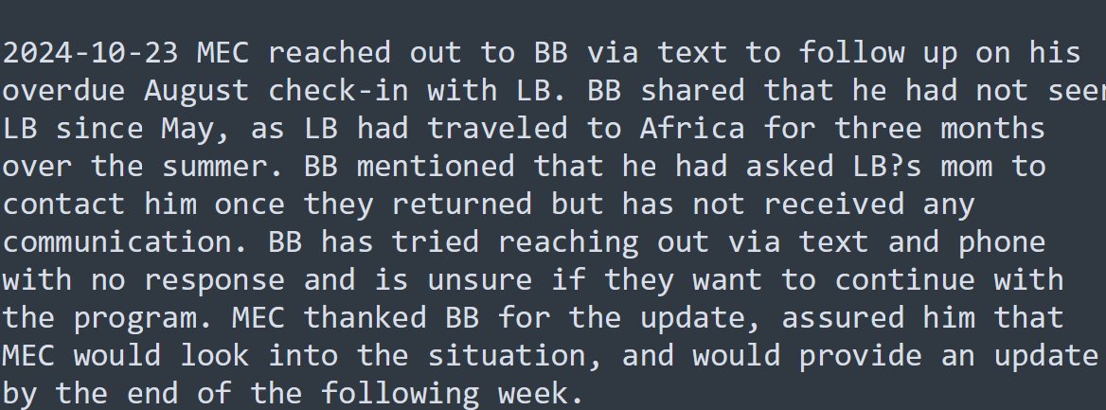

Grok Query Structure
Monthly Volunteer Mentor Catchup Notes
Output Format Prompt
Output Validation
Context Cache
Optimization to reduce input token count
Serialize Into JSON
Context Information (Flags & Events)
Transpose Feature To Columns
Match Rational Notes, events mentioned here doubles the green flag count

Slide 14
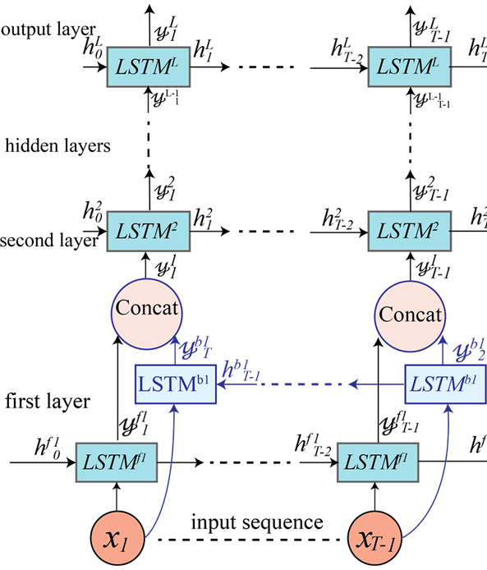
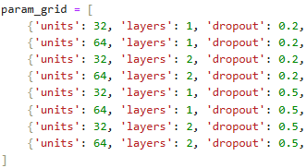
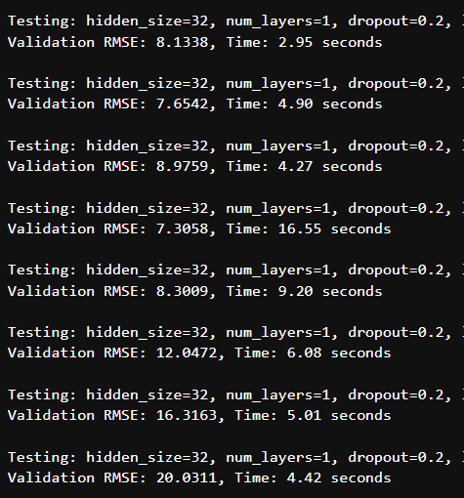

LSTM Pipeline
Feature Engineering
NParray Sequence
LSTM Model Parameters
Hyperparameter Tuning
0
1
n
Numerical Columns
Categorical Columns
Hidden Size:
256
Layers:
2
Learning Rate: 0.0005
Batch Size:
32
Regularization:
0.3
X = [R3 , R4 , R5, R6] | Y =R7[Match Len]
X = [R1 , R2 , R3, R4] | Y =R5[Match Len]
X = [R2 , R3 , R4, R5] | Y =R6[Match Len]
Normalization
One Hot Encoder
KNN Imputer (K=5)
Predictions

Slide 15
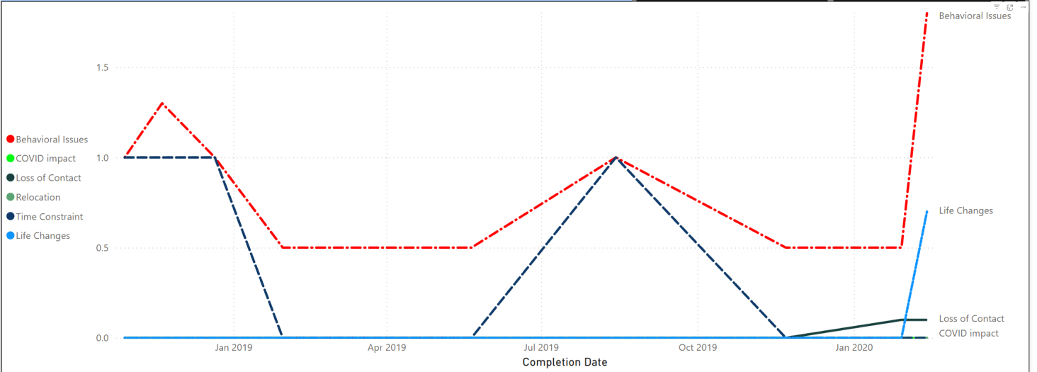
Match ID: a1v2J0000027dBaQAI
BS did say that she’s hoping to attend the Winter Picnic, but still has not reached P/G.
MEC isn’t sure the future of this match as BS seems frustrated and disheartened in the lack of engagement, enthusiasm and communication from P/G.
BS cannot commit their time to the match anymore due to family matters, and is looking to close. BS had talked to PG, and they’re in agreement about the match closing. They’re working together to find the healthiest closure option for LS

Slide 16
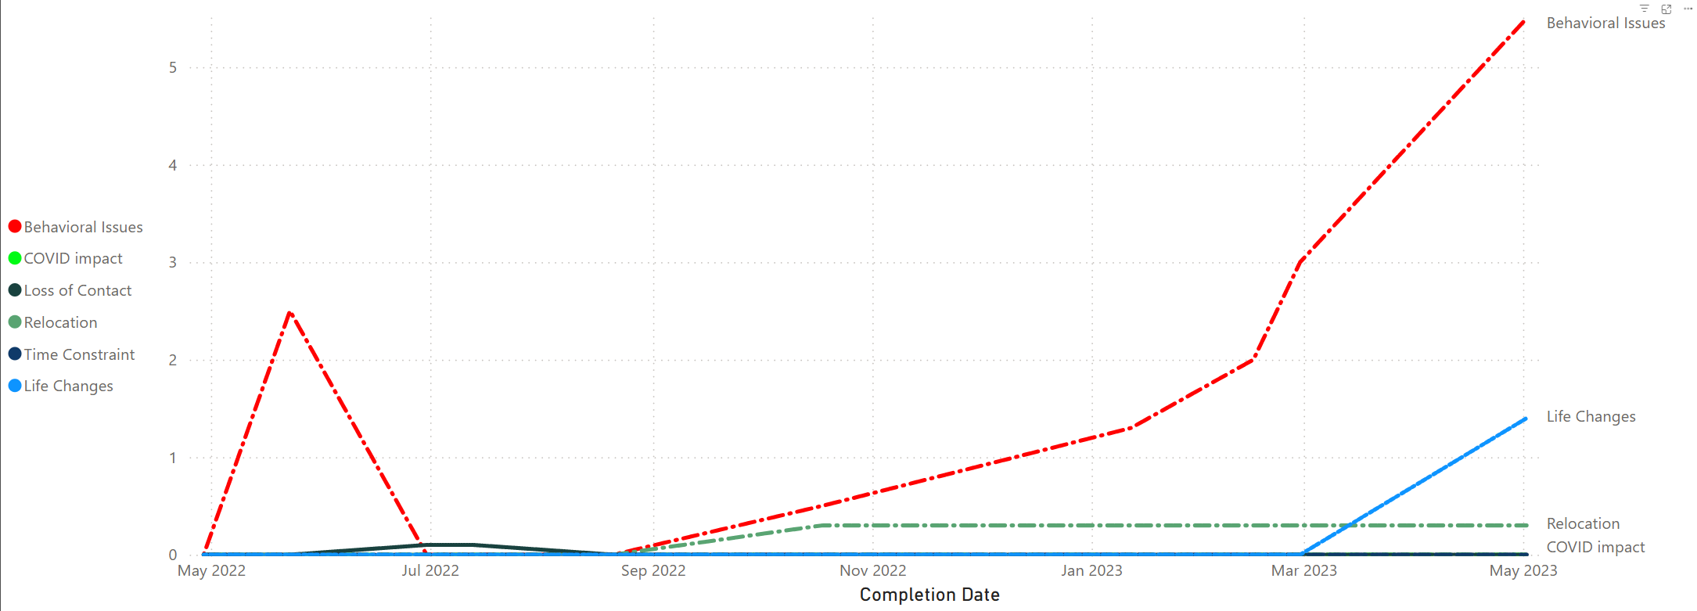
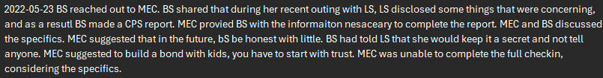
MatchID: a1v2J000003LH2lQAG
Big contacted the Match Engagement Coordinator to request match closure, explaining that she was pregnant and had been severely ill for two months, preventing her from seeing her Little (Nariah) since their last conversation.
Big said she "no longer feels she is getting anything out of it". MEC aknowledged her feelings and asked her to consider the benefits that Little is getting from the relationship and if she feels that is important. Big said she feels really guilty but she no longer wants to support Little if she isn't willing to at the minimum meet her with a match goal.

